Slide 1

Capital Budgeting
Msc Corporate Financial Management
Lille Campus - 18 hours
Skema Business School
Step 4B: Understand role of capital structure on capital budgeting
"Debt and Taxes"
Pr. Sébastien DEREEPER
Sebastien.Dereeper@skema.edu
Course Based on :
J. Berk & P. De Marzo - Corporate Finance - Pearson, 2024
Notes:
If this PowerPoint presentation contains mathematical equations, you may need to check that your computer has the following installed:
1) Math Type Plugin
2) Math Player (free versions available)
3) NVDA Reader (free versions available)

Slide 2
Outline
1 The Interest Tax Deduction
2 Valuing the Interest Tax Shield
3 Recapitalizing to Capture the Tax Shield
4 Personal Taxes
5 Optimal Capital Structure with Taxes

Slide 3
Learning Objectives (1 of 3)
Explain the effect of interest payments on cash flows to investors.
Calculate the interest tax shield, given the corporate tax rate and interest payments.
Calculate the value of a levered firm.
Calculate the weighted average cost of capital with corporate taxes.
Describe the effect of a leveraged recapitalization on the value of equity.

Slide 4
Learning Objectives (2 of 3)
Describe the effect of personal taxes on the corporate tax benefits of leverage.
Given corporate and personal tax rates on equity and debt, calculate the tax benefit of debt with personal taxes.
Discuss why the optimal level of leverage from a tax-saving perspective is the level at which interest equals E B I T.

Slide 5
Learning Objectives (3 of 3)
Describe the relationship between the optimal fraction of debt and the growth rate of the firm.
Assess the apparent under-leveraging of corporations, both domestically and internationally.

Slide 6
1 The Interest Tax Deduction (1 of 5)
Corporations pay taxes on their profits after interest payments are deducted
  Thus, interest expense reduces the amount of corporate taxes
  This creates an incentive to use debt

Slide 7
1 The Interest Tax Deduction (2 of 5)
Consider Macy’s, which had earnings before interest and taxes of approximately $2.8 billion in 2014 and interest expenses of about $400 million
  Macy’s marginal corporate tax rate was 35%
As shown on the next slide, Macy’s net income in 2014 was lower with leverage than it would have been without leverage

Slide 8
Table 1
Macy’s Income with and Without Leverage, Fiscal Year 2014 ($ million)
Blank | With Leverage | Without Leverage
E B I T | $2800 | $2800
Interest expense | Negative 400. | 0
Income before tax | 2400 | 2800
Taxes (35%) | Negative 840. | Negative 980.
Net income | $1560 | $1820

Slide 9
1 The Interest Tax Deduction (3 of 5)
Macy’s debt obligations reduced the value of its equity
But the total amount available to all investors was higher with leverage
Blank | With Leverage | Without Leverage
Interest paid to debt holders | 400 | 0
Income available to equity holders | 1560 | 1820
Total available to all investors | $1960 | $1820

Slide 10
1 The Interest Tax Deduction (4 of 5)
Without leverage, Macy’s was able to pay out $1820 million in total to its investors
With leverage, Macy’s was able to pay out $1960 million in total to its investors
Where does the additional $140 million come from?

Slide 11
1 The Interest Tax Deduction (5 of 5)
Interest Tax Shield
  The reduction in taxes paid due to the tax deductibility of interest
    In Macy’s case, the gain is equal to the reduction in
    taxes with leverage:
    The interest payments provided a tax savings of

Slide 12
Example 1 (1 of 2)
Computing the Interest Tax Shield
Problem
Shown below is the pro-forma forecasted income statement for D.F Builders (D F B), Given its marginal corporate tax rate of 25%, what is the amount of the interest tax shield for D F Bin year 2023 through 2026?
D F B Income statement ($ million) | 2023 | 2024 | 2025 | 2026
Total sales Cost of sales Selling, general, and administrative expense Depreciation | $3369 −2359 −22 −226 | $3706 −2584 −25 −248 | $4077 −2867 −27 −276 | $4432 −3116 −29 −299
Operating income Other income | 762 7 | 849 8 | 907 10 | 988 12
E B I T Interest expense | 769 −50 | 857 −80 | 917 −100 | 1000 −100
Income before tax Taxes (25%) | 719 −180 | 777 −194 | 817 −204 | 900 −225
Net income | $539 | $583 | $613 | $675

Slide 13
Example 1 (2 of 2)
Solution
From equationequat, the interest tax shield is the tax rate of 25% multiplied by the interest payments in each year:
($ million) | 2023 | 2024 | 2025 | 2026
Interest expense | −50 | −80 | −100 | −100
Interest tax shield left parenthesis 25 percent times interest expense right parenthesis. | 12.5 | 20 | 25 | 25
Thus, the interest tax shield enabled D F B to pay an additional $82.5 million to its investors over this period.

Slide 14
2 Valuing the Interest Tax Shield
When a firm uses debt, the interest tax shield provides a corporate tax benefit each year
This benefit is the computed as the present value of the stream of future interest tax shields the firm will receive

Slide 15
The Interest Tax Shield and Firm Value (1 of 2)
The cash flows a levered firm pays to investors will be higher than they would be without leverage by the amount of the interest tax shield

Slide 16
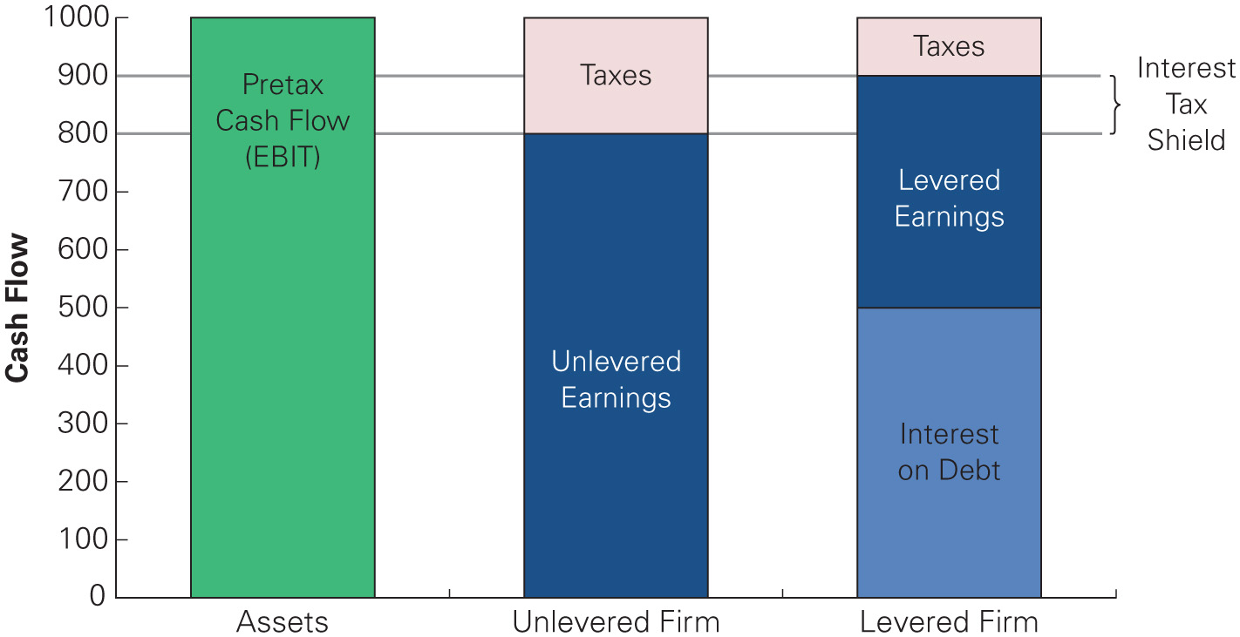
Figure 1
The Cash Flows of the Unlevered and Levered Firm
Notes:
Long Description:
The vertical axis represents cash flow ranging from 0 to 1000 in increments of 100. The data are as follows: assets: pretax cash flow,
E B I T, 1000; unlevered firm: unlevered earning, 800 and taxes. 200; levered firm: interest on debt, 500; levered earnings, 400; and taxes, 100. The interest tax shield is from 800 to 900.

Slide 17
The Interest Tax Shield and Firm Value (2 of 2)
M M Proposition
with Taxes
  The total value of the levered firm exceeds the value of the firm without leverage due to the present value of the tax savings from debt:

Slide 18
Example 2 (1 of 2)
Valuing the Interest Tax Shield Without Risk
Problem
Suppose D F B restructures its existing debt, and will instead pay $80 million in interest each year for the next 10 years, and then repay the principal of $1.6 billion in year 10. These payments are risk free, and D F B’s marginal tax rate will remain 25% throughout this period. If the risk-free interest rate is 5%, by how much does the interest tax shield increase the value of D F B?

Slide 19
Example 2 (2 of 2)
Solution
In this case, the interest tax shield is
each year for the next 10 years. Therefore, we can value it as a 10-year annuity. Because the tax savings are known and not risky, we can discount them at the 5% risk-free rate:
The final repayment of principle in year 10 is not deductible, so it does not contribute to the tax shield.

Slide 20
The Interest Tax Shield with Permanent Debt (1 of 4)
Typically, the level of future interest payments is uncertain due to changes in the marginal tax rate, the amount of debt outstanding, the interest rate on that debt, and the risk of the firm
  For simplicity, we will consider the special case in which the above variables are kept constant

Slide 21
The Interest Tax Shield with Permanent Debt (2 of 4)
Suppose a firm borrows debt D and keeps the debt permanently
If the firm’s marginal tax rate is
and if the debt is
riskless with a risk-free interest rate
then the interest
tax shield each year is
and the tax shield can
be valued as a perpetuity:
Notes:
Long Description:
Upper P upper V left parenthesis interest tax shield right parenthesis equals start fraction tau subscript c baseline times interest over r subscript f end fraction equals start fraction tau subscript c baseline times left parenthesis r subscript f baseline times upper D right parenthesis over r subscript f end fraction.

Slide 22
The Interest Tax Shield with Permanent Debt (3 of 4)
If the debt is fairly priced, no arbitrage implies that its market value must equal the present value of the future interest payments:

Slide 23
The Interest Tax Shield with Permanent Debt (4 of 4)
If the firm’s marginal tax rate is constant, then

Slide 24
The Weighted Average Cost of Capital with Taxes
With tax-deductible interest, the effective after-tax
borrowing rate is
and the weighted average
cost of capital becomes
Notes:
Long Description 1:
r subscript upper W a c c baseline equals start fraction upper E over upper E plus upper D end fraction r subscript upper E baseline plus start fraction upper D over upper E plus upper D end fraction r subscript upper D baseline left parenthesis 1 minus tau subscript c baseline right parenthesis.
Long Description 2:
r subscript upper W a c c baseline equals start fraction upper E over upper E plus upper D end fraction r subscript upper E baseline plus start fraction upper D over upper E plus upper D end fraction r subscript upper D baseline minus start fraction upper D over upper E plus upper D end fraction r subscript upper D baseline tau subscript c. A text below the expression upper E over upper E plus upper D end fraction r subscript upper E baseline plus start fraction upper D over upper E plus upper D end fraction r subscript upper D reads, pretax upper W upper A upper C upper C. A text below the expression upper D over upper E plus upper D end fraction r subscript upper D baseline tau subscript c reads, reduction due to interest tax shield.

Slide 25
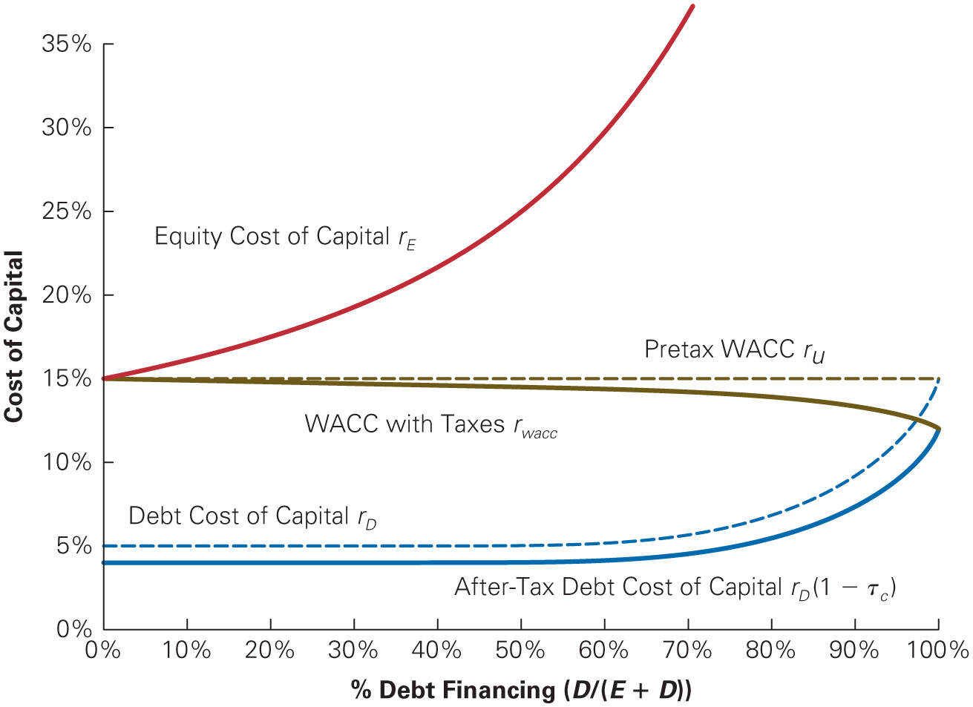
Figure 2
The W A C C with and Without Corporate Taxes
Notes:
Long Description:
The horizontal axis represents the percentage of debt financing, left parenthesis D over left parenthesis E plus D right parenthesis right parenthesis. The vertical axis represents the cost of capital ranging from 0 percent to 35 percent in increments of 5 percent. The curve representing equity cost of capital r subscript upper E passes through (0, 15), (20, 17.5), (50, 25), and (65, 34). The straight line parallel to the horizontal axis represents Pretax W A C C r subscript U passing through the following (0, 15) and (100, 15). The curve representing W A C C with taxes r subscript W A C C passes through the following (0, 15), (75, 14), and (100, 12.5). The curve representing the debt cost of capital r subscript upper D passes through the following (0, 5), (80, 6), and (100, 15). The curve representing after-tax debt cost of capital r subscript upper D left parenthesis 1 minus tau sub C right parenthesis passes through the following (0, 4), (80, 5), and (100, 12.5). All values are approximate.

Slide 26
The Interest Tax Shield with a Target Debt-Equity Ratio (1 of 2)
When a firm adjusts its leverage to maintain a target debt-equity ratio, we can compute its value with leverage,
by discounting its free cash flow using the weighted
average cost of capital

Slide 27
The Interest Tax Shield with a Target Debt-Equity Ratio (2 of 2)
The value of the interest tax shield can be found by
comparing the value of the levered firm,
to the
unlevered value,
of the free cash flow discounted at
the firm’s unlevered cost of capital, the pretax W A C C

Slide 28
Example 3 (1 of 3)
Valuing the Interest Tax Shield with a Target Debt-Equity Ratio
Problem
Western Lumber Company expects to have free cash flow in the coming year of $4.25 million, and its free cash flow is expected to grow at a rate of 4% per year thereafter. Western Lumber has an equity cost of capital of 10% and a debt cost of capital of 6%, and it pays a corporate tax rate of 21%.
If Western Lumber maintains a debt-equity ratio of
what is the value of its interest tax shield?

Slide 29
Example 3 (2 of 3)
Solution
We can estimate the value of western Lumber’s interest tax shield by comparing its value with and without leverage. We compute its unlevered value by discounting its free cash flow at its pretax W A C C:
Because western Lumber’s free cash flow is expected to grow at a constant rate, we can value it as a constant growth perpetuity:
To compute western Lumber’s levered value, we calculate its W A C C :
Notes:
Long Description:
Pre-tax upper W upper A upper C upper C equals start fraction upper E over upper E plus upper D end fraction r subscript upper E baseline plus start fraction upper D over upper E plus upper D end fraction r subscript upper D baseline equals start fraction 1 over 1 plus 0.5 end fraction 10 percent plus start fraction 0.5 over 1 plus 0.5 end fraction 6 percent equals 8.67 percent.

Slide 30
Example 3 (3 of 3)
Thus, Western Lumber’s value including the interest tax shield is
The value of the interest tax shield is therefore
Notes:
Long Description:
Upper W upper A upper C upper C equals start fraction upper E over upper E plus upper D end fraction r subscript upper E baseline plus start fraction upper D over upper E plus upper D end fraction r subscript upper D baseline left parenthesis 1 minus tau subscript c baseline right parenthesis.

Slide 31
3 Recapitalizing to Capture the Tax Shield
Assume that Midco Industries wants to boost its stock price
The company currently has 20 million shares outstanding with a market price of $15 per share and no debt
Midco has had consistently stable earnings and pays a 21% tax rate
Management plans to borrow $100 million on a permanent basis, and they will use the borrowed funds to repurchase outstanding shares

Slide 32
The Tax Benefit (1 of 3)
Without leverage
If Midco borrows $100 million using permanent debt, the present value of the firm’s future tax savings is

Slide 33
The Tax Benefit (2 of 3)
Thus the total value of the levered firm will be
Because the value of the debt is $100 million, the value of the equity is

Slide 34
The Tax Benefit (3 of 3)
Although the value of the shares outstanding drops to $221 million, shareholders will also receive the $100 million that Midco will pay out through the share repurchase
In total, they will receive the full $321 million, a gain of $21 million over the value of their shares without leverage

Slide 35
The Share Repurchase (1 of 3)
Assume Midco repurchases its shares at the current price of $15 per share
The firm will repurchase 6.67 million shares
It will then have 13.33 million shares outstanding

Slide 36
The Share Repurchase (2 of 3)
The total value of equity is $221 million; therefore, the new share price is $16.575 per share
Shareholders who keep their shares earn a capital gain of $1.575 per share

Slide 37
The Share Repurchase (3 of 3)
The total gain to shareholders is $21 million
If the shares are worth $16.575 per share after the repurchase, why would shareholders tender their shares to Midco at $15 per share?

Slide 38
No Arbitrage Pricing (1 of 4)
If investors could buy shares for $15 immediately before the repurchase and sell these shares immediately afterward at a higher price, this would represent an arbitrage opportunity

Slide 39
No Arbitrage Pricing (2 of 4)
Realistically, the value of the Midco’s equity will rise immediately from $300 million to $321 million after the repurchase announcement
With 20 million shares outstanding, the share price will
rise to
per share

Slide 40
No Arbitrage Pricing (3 of 4)
With a repurchase price of
the shareholders who
tender their shares and the shareholders who hold their
shares both gain
per share as a result of the
transaction

Slide 41
No Arbitrage Pricing (4 of 4)
The benefit of the interest tax shield goes to all 20 million of the original shares outstanding for a total benefit of $21 million
When securities are fairly priced, the original shareholders of a firm capture the full benefit of the interest tax shield from an increase in leverage

Slide 42
Example 4 (1 of 3)
Alternative Repurchase Prices
Problem
Suppose Midco announces a price at which it will repurchase $100 million worth of its shares.
Show that
is the lowest price it could offer and
expect shareholders to tender their shares.
How will the benefits be divided if Midco offers more than
per share?

Slide 43
Example 4 (2 of 3)
Solution
For each repurchase price, we can compute the number of shares Midco will repurchase, as will as the number of shares that will remain after the share repurchase. Dividing the $221 million total value of equity by the number of remaining shares gives Midco’s new share price after the transaction. No shareholders will be willing to sell their share unless the repurchase price is at least as high as the share price after the transaction. No shareholders will be willing to sell their shares unless the repurchase price is at least as high as the share price after the transaction; otherwise, they would be better off waiting to sell their shares. As the table
show, the repurchase price must be at least
for
shareholders to be willing to sell rather then waiting to receive a higher price.

Slide 44
Example 4 (3 of 3)
Repurchase price ($/share) | Share Repurchase (million) | Shares Remaining (million) | New Share Price ($/share)
P subscript R. | R equals 100 over P subscript R. | N equals 20 minus R. | P subscript N baseline equals 221 over N.
15.00 | 6.67 | 13.33 | $16.58
15.55 | 6.43 | 13.57 | 16.29
16 Point 0 5 | 6.23 | 13.77 | 5 16 Point 05
16.55 | 6 point 04 | 13.96 | 15.83
17 Point 05 | 5.87 | 14.13 | 15.64
If Midco offers a price above
then all existing shareholders will be eager
to sell their shares, because the shares will have a lower value after the transaction is completed. In this case, Midco’s offer to repurchase shares will be oversubscribed and Midco will need to use a lottery or some other rationing mechanism to choose from whom it will repurchase shares. In that case, more of the benefits of the recap will go to the shareholders who are lucky enough to be selected for the repurchase.

Slide 45
Analyzing the Recap: The Market Value Balance Sheet
In the presence of corporate taxes, we must include the interest tax shield as one of the firm’s assets

Slide 46
Table 2
Market Value Balance Sheet for the Steps in Midco’s Leveraged Recapitalization
Market Value Balance Sheet ($ million) | Initial | Step 1: Recap Announced | Step 2: Debt Issuance | Step 3: Share Repurchase
Assets
Cash | 0 | 0 | 100 | 0
Original assets Left parenthesis V superscript U baseline right parenthesis. | 300 | 300 | 300 | 300
Interest tax shield | 0 | 21 | 21 | 21
Total assets | 300 | 321 | 421 | 321
Liabilities
Debt | 0 | 0 | 100 | 100
Equity = Assets − Liabilities | 300 | 321 | 321 | 221
Shares outstanding (million) | 20 | 20 | 20 | 13.77
Price per share | 15 point 00 dollars. | 16 point 05 dollars. | 16 point 05 dollars. | 16 point 05 dollars.

Slide 47
4 Personal Taxes (1 of 2)
The cash flows to investors are typically taxed twice. Once at the corporate level and then investors are taxed again when they receive their interest or divided payment

Slide 48
4 Personal Taxes (2 of 2)
For individuals
  Interest payments received from debt are taxed as income
  Equity investors also must pay taxes on dividends and capital gains

Slide 49
Including Personal Taxes in the Interest Tax Shield (1 of 4)
The amount of money an investor will pay for a security depends on the cash flows the investor will receive after all taxes have been paid
Personal taxes reduce the cash flows to investors and can offset some of the corporate tax benefits of leverage

Slide 50
Including Personal Taxes in the Interest Tax Shield (2 of 4)
The actual interest tax shield depends on both corporate and personal taxes that are paid
To determine the true tax benefit of leverage, the combined effect of both corporate and personal taxes needs to be evaluated

Slide 51
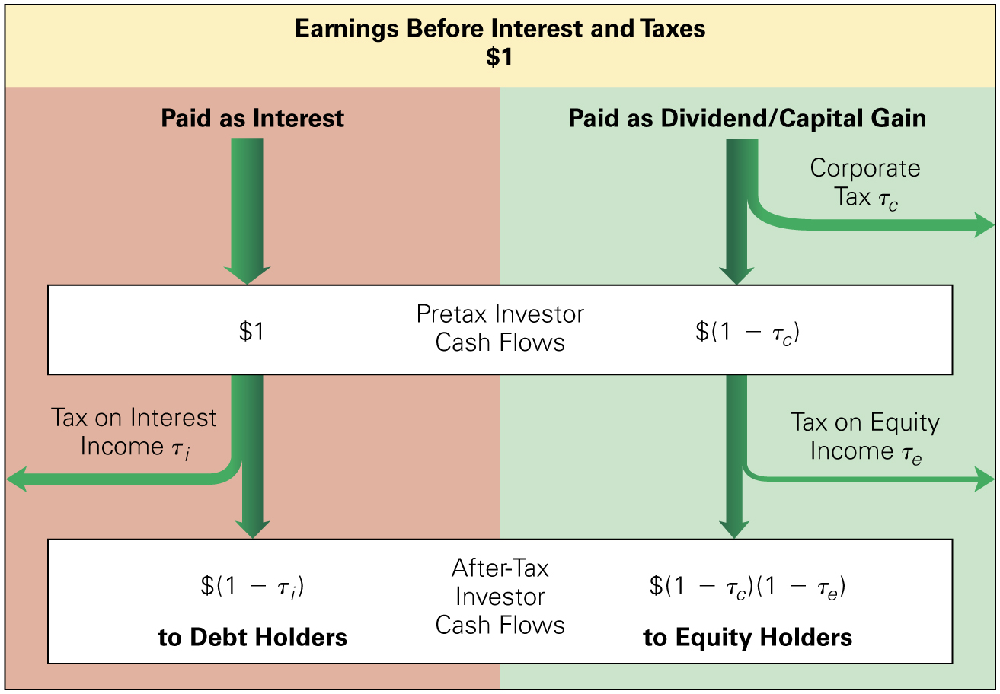
Figure 3
After-Tax Investor Cash Flows Resulting from $1 in E B I T
Notes:
Long Description:
The earnings before interest and taxes, 1 dollar shows the following: paid as interest leads to 1 dollar, pretax investor cash flows, this leads to tax on interest income, T subscript i and after-tax investor cash flows, left parenthesis 1 minus T subscript i right parenthesis dollars to debt holders. Paid as dividend or capital gain leads to corporate tax, T subscript c and pretax investor cash flows, left parenthesis 1 minus T subscript i right parenthesis; this leads to tax on equity income, T subscript e and after-tax investor cash flows, left parenthesis 1 minus T subscript C right parenthesis left parenthesis 1 minus T subscript e right parenthesis to equity holders.

Slide 52
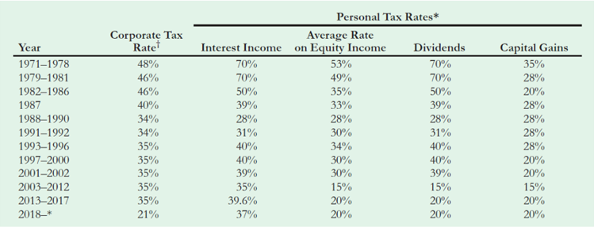
Table 3
Top Federal Tax Rates in the United States, 1971–2022
* Interest income is taxed as ordinary income. Until 2003, dividends were also taxed as ordinary income. The average tax rate on equity income is an average of dividend and capital gain tax rates (consistent with a 50% dividend payout ratio and annual realization of capital gains), where the capital gain tax rate is the long-term rate applicable to assets held more than one year. Since 2013, some investors are also subject to an additional 3.8% net investment income tax on both interest and equity income.
The corporate rate shown is for C corporations with the highest level of income. Marginal rates can be higher for lower
brackets. (For example, between 2000 and 2017, the 35% tax rate applied to income levels above $18.3 million, while the tax rate for income levels between $100,000 and $335,000 was 39%.)
Notes:
Long Description:
The personal tax rates asterisk shows year, corporate tax rate, interest income, average rate on equity income, dividends, and capital gains and they are as follows: 1971 to 1978, 48 percent, 70 percent, 53 percent, 70 percent, 35 percent, 1979 to 1981, 46 percent, 70 percent, 49 percent, 70 percent, 28 percent, 1982 to 1986, 46 percent, 50 percent, 35 percent, 50 percent, 20 percent, 1987 40 percent, 39 percent, 33 percent, 39 percent, 28 percent, 1988 to 1990, 34 percent, 28 percent, 28 percent, 28 percent, 28 percent, 1991–1992 34 percent, 31 percent, 30 percent, 31 percent, 28 percent, 1993 to 1996, 35 percent, 40 percent, 34 percent, 40 percent, 28 percent, 1997 to 2000, 35 percent, 40 percent, 30 percent, 40 percent, 20 percent, 2001 to 2002, 35 percent, 39 percent, 30 percent, 39 percent, 20 percent, 2003 to 2012, 35 percent, 35 percent, 15 percent, 15 percent, 15 percent, 2013 to 2017, 35 percent, 39.6 percent, 20 percent, 20 percent, 20 percent, 2018 to asterisks, 21 percent, 37 percent, 20 percent, 20 percent, 20 percent. The asterisk reads the following: Interest income is taxed as ordinary income. Until 2003, dividends were also taxed as ordinary income. The average tax rate on equity income is an average of dividend and capital gain tax rates, consistent with a 50 percent dividend payout ratio and annual realization of capital gains, where the capital gain tax rate is the long-term rate applicable to assets held more than one year. Since 2013, some investors are also subject to an additional 3.8 percent, net investment income tax on both interest and equity income. The corporate tax rate reads the corporate rate shown is for C corporations with the highest level of income. Marginal rates can be higher for lower brackets. For example, between 2000 and 2017, the 35 percent tax rate applied to income levels above $18.3 million, while the tax rate for income levels between 100,000 dollars and 335,000 dollars was 39 percent.

Slide 53
Including Personal Taxes in the Interest Tax Shield (3 of 4)
In general, every $1 received after taxes by debt holders
from interest payments costs equity holders
on an after-tax basis, where
  Effective Tax Advantage of Debt
Notes:
Long Description:
Tau superscript asterisk baseline equals start fraction left parenthesis 1 minus tau subscript i baseline right parenthesis minus left parenthesis 1 minus tau subscript c baseline right parenthesis left parenthesis 1 minus tau subscript e baseline right parenthesis over left parenthesis 1 minus tau subscript i baseline right parenthesis end fraction equals 1 minus start fraction left parenthesis 1 minus tau subscript c baseline right parenthesis left parenthesis 1 minus tau subscript e baseline right parenthesis over left parenthesis 1 minus tau subscript i right parenthesis.

Slide 54
Including Personal Taxes in the Interest Tax Shield (4 of 4)
When there are no personal taxes on debt income
or when the personal tax rates on debt and equity income
  are the same
the formula reduces to
  When equity income is taxed less heavily
  is less
  than
  then
is less than
Notes:
Long Description:
Tau superscript asterisk baseline equals start fraction left parenthesis 1 minus tau subscript i baseline right parenthesis minus left parenthesis 1 minus tau subscript c baseline right parenthesis left parenthesis 1 minus tau subscript e baseline right parenthesis over left parenthesis 1 minus tau subscript i baseline right parenthesis end fraction equals 1 minus start fraction left parenthesis 1 minus tau subscript c baseline right parenthesis left parenthesis 1 minus tau subscript e baseline right parenthesis over left parenthesis 1 minus tau subscript i right parenthesis.

Slide 55
Example 5 (1 of 2)
Calculating the Effective Tax Advantage of Debt
Problem
What was the effective tax advantage of debt in 1980? In 1990?

Slide 56
Example 5 (2 of 2)
Solution
Using Equation and the tax rates in table 3, we can calculate
Given the tax rates at the time, the effective tax advantage of debt was much lower in 1980 than in 1990.

Slide 57
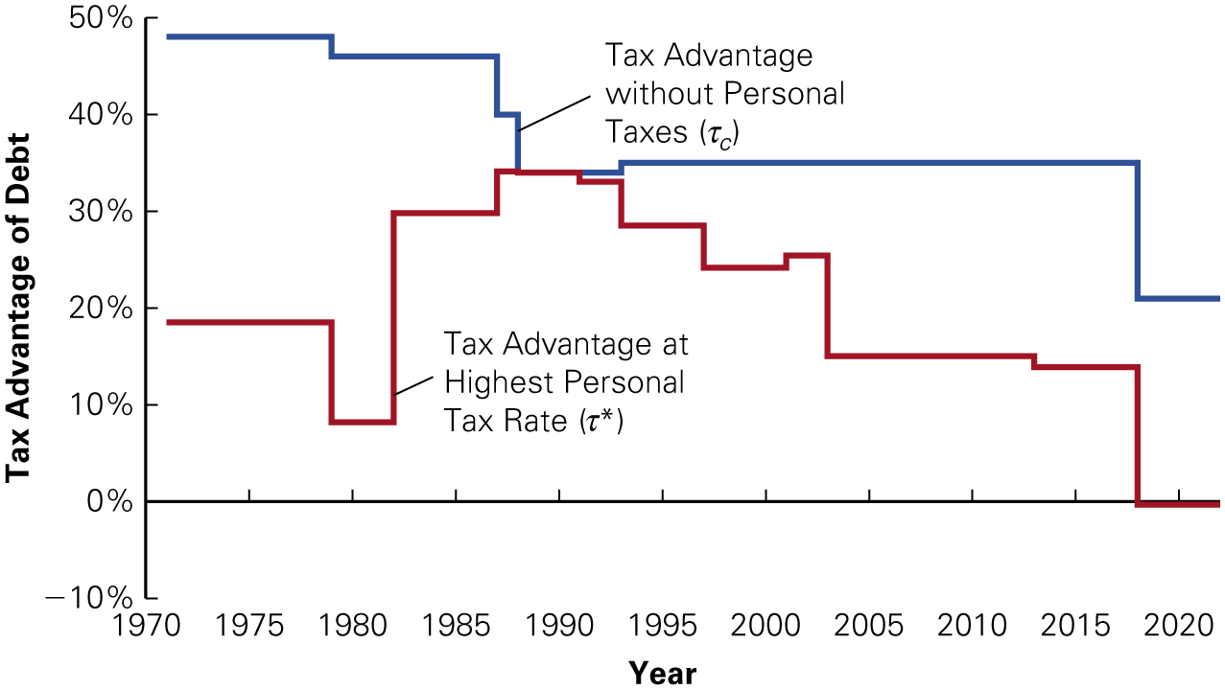
Figure 4
The Effective Tax Advantage of Debt with and Without Personal Taxes, 1971–2022
Notes:
Long Description:
The horizontal axis represents years ranging from 1970 to 2020 in increments of 5. The vertical axis represents the tax advantage of debt ranging from negative 10 percent to 50 percent in increments of 10. The step curve representing tax advantage without personal taxes, tau subscript c passes through the following: (1970, 49), (1980, 46), (1985, 46), (1985, 39), (1986, 36), (1995, 34), (2015, 34), and (2020, 20). The step curve representing tax advantage at the highest personal tax rate, tau asterisk passes through the following: (1970, 19), (1980, 8), (1985, 29), (1990, 30), (2000, 25), (2005, 13), (2015, 12), and (2020, 0).

Slide 58
5 Optimal Capital Structure with Taxes (1 of 3)
Do Firms Prefer Debt?
  When firms raise new capital from investors, they do so primarily by issuing debt
  In most years, aggregate equity issues are negative, meaning that on average, firms are reducing the amount of equity outstanding by buying shares

Slide 59
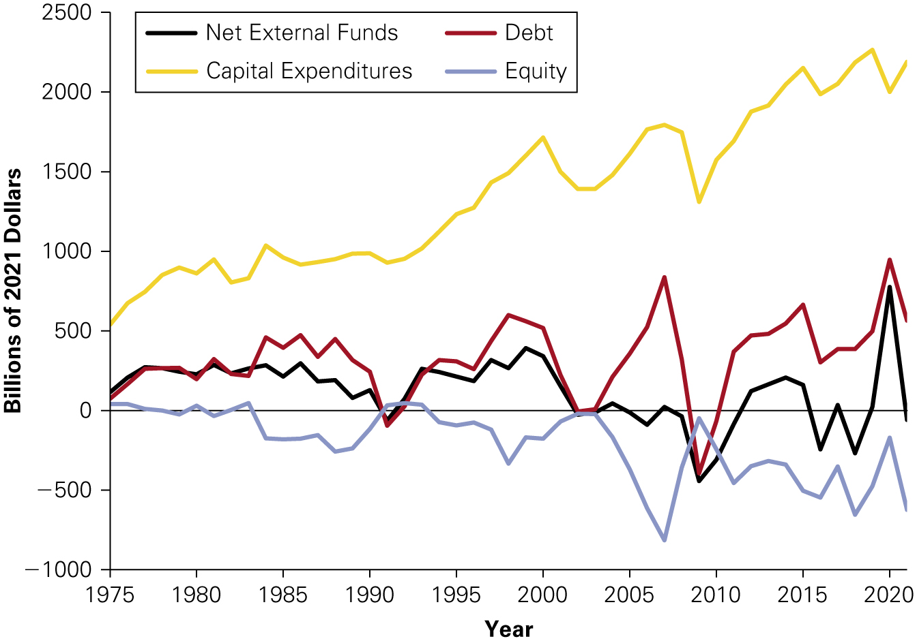
Figure 5
Net External Financing and Capital Expenditures by U.S. Corporations, 1975–2021
Source: Federal Reserve, Flow of Funds Accounts of the United States, 2021.
Notes:
Long Description:
The horizontal axis represents years ranging from 1975 to 2020 in increments of 5. The vertical axis represents billion of 2021 dollars ranging from negative 1000 to 2500 dollars in increments of 500. The curve representing net external funds passes through the following: (1975, 50), (1985, 200), (1995, 220), (2005, 0), and (2020, 700). The curve representing debt passes through the following: (1975, 50), (1985, 450), (1995, 250), (2005, 750), and (2020, 750). The curve representing capital expenditures passes through the following: (1975, 550), (1985, 950), (1995, 1400), (2005, 1600), and (2020, 2000). The curve representing equity passes through the following: (1975, 0), (1985, negative 200), (1995, negative 100), (2005, negative 700), and (2020, negative 200). All values are approximate.

Slide 60
5 Optimal Capital Structure with Taxes (2 of 3)
Do Firms Prefer Debt?
  While firms seem to prefer debt when raising external funds, not all investment is externally funded
  Most investment and growth is supported by internally generated funds
    Even though firms have not issued new equity, the market value of equity has risen over time as firms have grown
    For the average firm, the result is that debt as a fraction of firm value has varied in a range from 30% to 45%

Slide 61
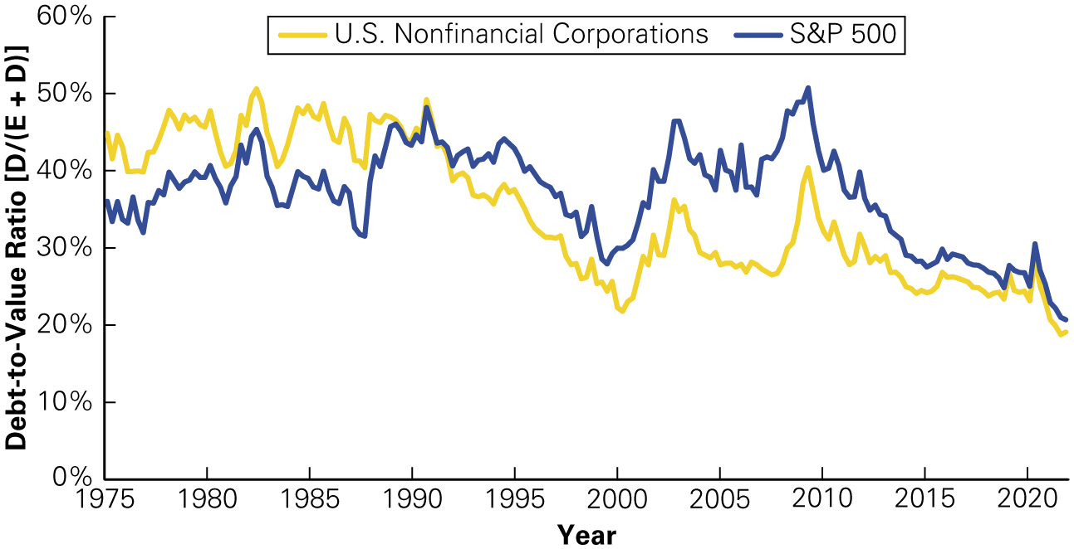
Figure 6
Debt-to-Value Ratio
of U.S. Firms, 1975–2021
Source: Compustat and Federal Reserve, Flow of Funds Accounts of the United States, 2021.
Notes:
Long Description:
The horizontal axis represents years ranging from 1975 to 2020 in increments of 5. The vertical axis represents the debt-to-value ratio, left bracket D over left parenthesis E plus D right parenthesis right bracket ranging from 0 percent to 60 percent in increments of 10. The curve representing U.S. nonfinancial corporations passes through the following: (1975, 42), (1985, 46), (1995, 37), (2005, 29), (2015, 25), and (2020, 20). The curve representing S and P 500 passes through the following: (1975, 35), (1985, 38), (1995, 40), (2005, 43), (2015, 27), and (202, 20). All values are approximate.

Slide 62
5 Optimal Capital Structure with Taxes (3 of 3)
Do Firms Prefer Debt?
  The use of debt varies greatly by industry
  Firms in growth industries like biotechnology or high technology carry very little debt, while airlines, automakers, utilities, and financial firms have high leverage ratios

Slide 63
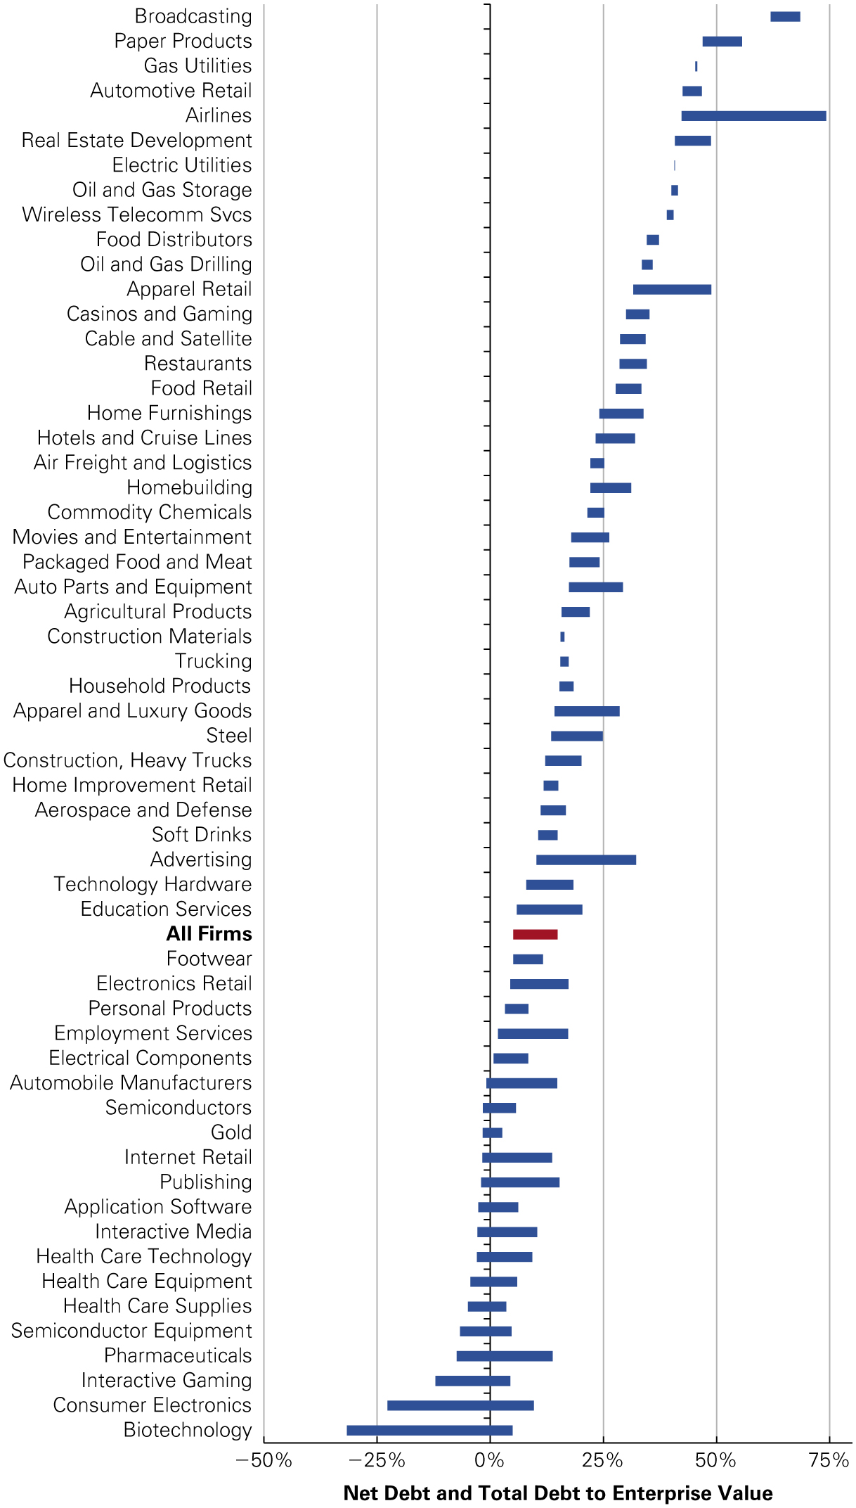
Figure 7
Debt-to-Enterprise Value Ratio for Select Industries
Source: Capital I Q, 2022
Notes:
Long Description:
The horizontal axis represents net debt and total debt to enterprise value ranging from negative 50 percent to 75 percent in increments of 25. The vertical axis represents different industries. The data are as follows: broadcasting, 75 to 80; paper products, 26 to 30; gas utilities, 40; automotive retail, 45 to 50; airlines, 42 to 74; real estate development electric utilities, 35 to 49; oil and gas storage, 40; wireless telecomm SVCS, 40; food distributors, 35; oil and gas drilling, 38; apparel retail, 35 to 49; casinos and gaming, 30 to 35; cable and satellite, 30 to 35; restaurants, 30 to 35; food retail, 30 to 35; home furnishings, 24 to 35; hotels and cruise lines, 24 to 35; air freight and logistics, 29 to 35; homebuilding, 23 to 30; commodity chemicals, 23 to 25; movies and entertainment, 15 to 26; packaged food and meat, 15 to 29; auto parts and equipment, 15 to 30; agricultural products, 15 to 20; construction materials, 16; trucking, 16; household products, 17; apparel and luxury goods steel, 15 to 30; construction, heavy trucks, 15 to 25; home improvement retail, 15; aerospace and defense, 15 to 20; soft drinks, 15 to 20; advertising, 15 to 20; technology hardware education services, 10 to 20; all firms, 10 to 18; footwear, 10 to 15; electronics retail, 6 to 18; personal products, 5 to 8; employment services, 2 to 18; electrical components, 2 to 10; automobile manufacturers, negative 1 to 15; semiconductors, negative 1 to 8; gold, negative 1 to 3; internet retail, negative 1 to 15; publishing, negative 1 to 15; application software, negative 2 to 7; interactive media, negative 2 to 15; health care technology, negative 2 to 14; health care equipment, negative 3 to 5; health care supplies, negative 3 to 2; semiconductor equipment, negative 5 to 3; pharmaceuticals, negative 5 to 16; interactive gaming, negative 15 to 3; consumer electronics, negative 23 to 12; and biotechnology, negative 30 to 5.

Slide 64
Limits to the Tax Benefit of Debt (1 of 7)
To receive the full tax benefits of leverage, a firm need not use 100% debt financing, but the firm does need to have taxable earnings
  This constraint may limit the amount of debt needed as a tax shield

Slide 65
Table 4
Corporate Tax Savings with Different Amounts of Leverage
Blank | Blank | No Leverage | Moderate Leverage | Excess Leverage
1 | E B I T | $1000 | $1000 | $1000
2 | Interest expense | 0 | 300 | 500
3 | 30% Income Limit | 300 | 300 | 300
4 | Interest Deduction (smaller of 2 and 3) | 0 | 300 | 300
5 | Taxable Income (1 – 4) | 1000 | 700 | 300
6 | Taxes (21% of 5) | 210 | 147 | 147
7 | Net income (1 – 2 – 6) | 790 | 553 | 353
Blank | Tax savings from leverage | $0 | $63 | $63

Slide 66
Limits to the Tax Benefit of Debt (2 of 7)
From the previous slide:
  With no leverage, the firm receives no tax benefit
  With moderate leverage, the firm saves $63 in taxes
  With excess leverage, the interest payments exceed the 30% income limit
    In this case, the allowed interest deduction is capped
    Hence, once the 30% limit is reached, there is no immediate tax shield from the excess leverage

Slide 67
Limits to the Tax Benefit of Debt (3 of 7)
No corporate tax benefit arises from incurring interest payments that regularly exceed the income limit
Because interest payments constitute a tax disadvantage at the investor level, investors will pay higher personal taxes with excess leverage, making them worse off

Slide 68
Limits to the Tax Benefit of Debt (4 of 7)
If the firm is not paying taxes, where
then the tax
disadvantage of excess leverage is
  Note:
  is negative because
Notes:
Long Description:
Tau subscript e x superscript asterisk baseline equals 1 minus start fraction left parenthesis 1 minus tau subscript e baseline right parenthesis over left parenthesis 1 minus tau subscript i baseline right parenthesis end fraction equals start fraction tau subscript e baseline minus tau subscript i over left parenthesis 1 minus tau subscript i baseline right parenthesis end fraction less than 0.

Slide 69
Limits to the Tax Benefit of Debt (5 of 7)
The optimal level of leverage from a tax saving perspective is the level such that interest equals E B I T
  At the optimal level of leverage, the firm shields all of its taxable income, and it does not have any tax-disadvantaged excess interest

Slide 70
Limits to the Tax Benefit of Debt (6 of 7)
However, it is unlikely that a firm can predict its future E B I T (and the optimal level of debt) precisely
  If there is uncertainty regarding E B I T, then there is a risk that interest will exceed E B I T
  As a result, the tax savings for high levels of interest falls, possibly reducing the optimal level of the interest payment

Slide 71
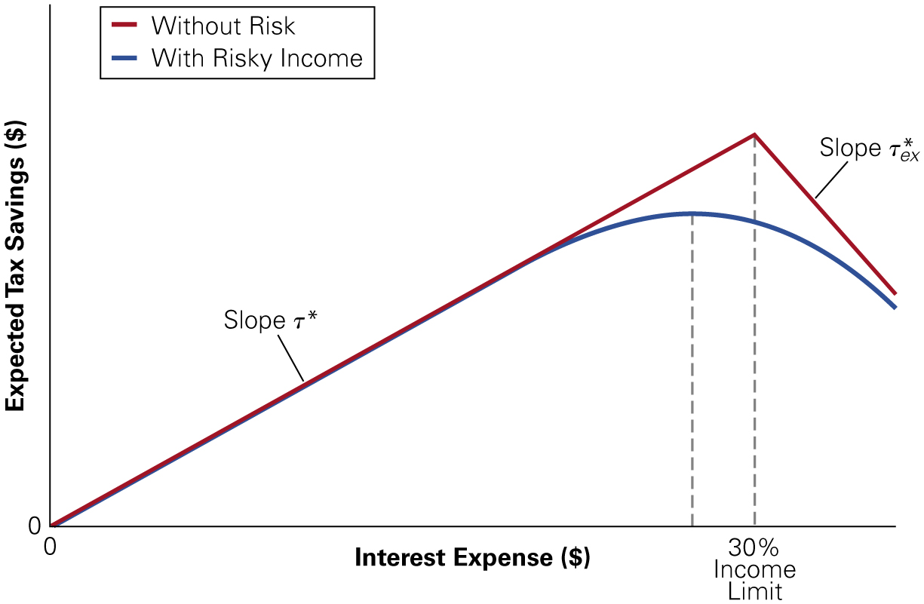
Figure 8
Tax Savings for Different Levels of Interest
Notes:
Long Description:
The horizontal axis represents interest expense in dollars. The vertical axis represents expected tax savings in dollars. The line representing without risk starts at 0 and increases gradually 30 percent income limit and then the curve decreases. The increasing slope is labeled slope tau asterisks and the decreasing slope is labeled slope tau asterisks subscript ex baseline. The line representing risky income increases gradually and at the end of interest expense, it decreases slowly.

Slide 72
Limits to the Tax Benefit of Debt (7 of 7)
In general, as a firm’s interest expense approaches its expected taxable earnings, the marginal tax advantage of debt declines, limiting the amount of debt the firm should use

Slide 73
The Low Leverage Puzzle (1 of 4)
The figure on the following slide reveals two important patterns:
  Firms have used debt to shield a greater percentage of their earnings from taxes in more recent years (mirroring the increase in the effective tax advantage of debt)
  Firms have far less leverage than our analysis of the interest tax shield would predict

Slide 74
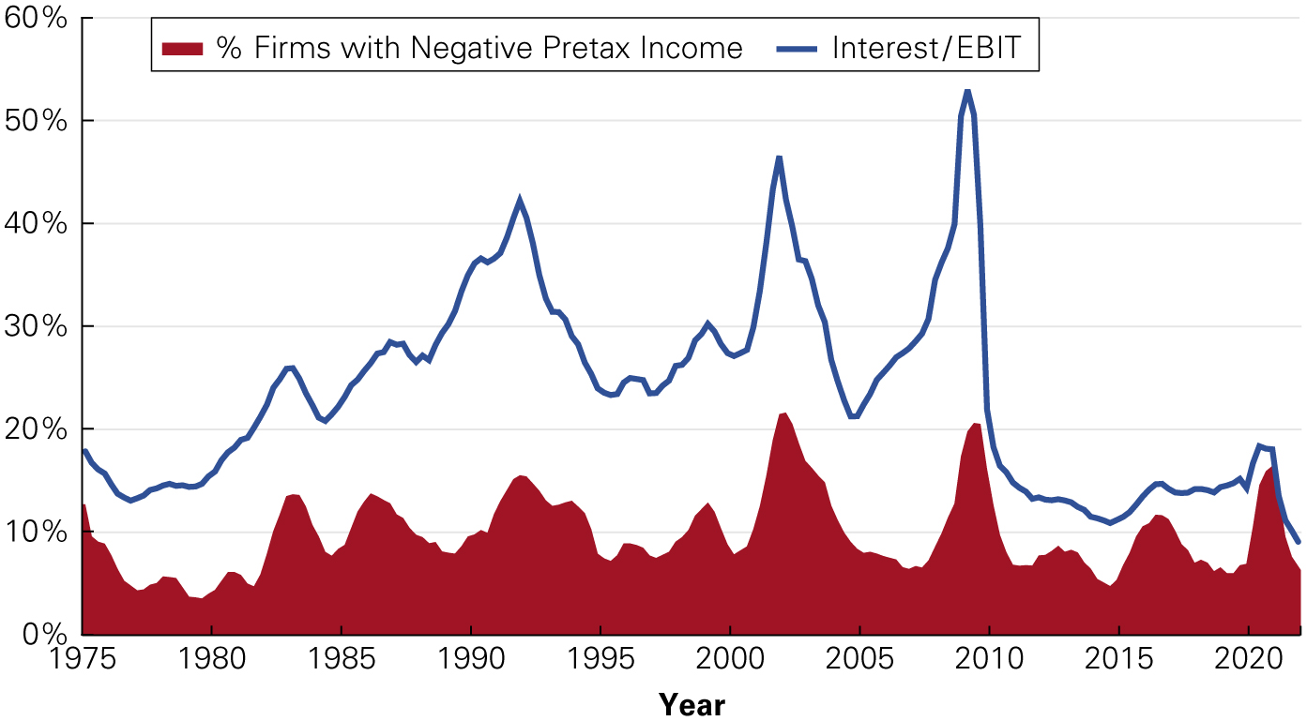
Figure 9
Interest Payments as a Percentage of E B I T and Percentage of Firms with Negative Pre-tax Income, S&P 500 1975–2021
Source: Compustat.
Notes:
Long Description:
The horizontal axis represents years ranging from 1975 to 2020 in increments of 5. The vertical axis ranges from 0 percent to 60 percent in increments of 10 percent. The line representing interest or EBIT passes through the following: (1975, 19 percent), (1985, 15 percent), (1995, 25 percent), (2005, 20 percent), (2010, 50 percent), (2015, 12 percent), and (2020, 16 percent). The area curve representing the percentage of firms with negative pretax income passes through the following: (1975, 13), (1985, 13), (1995, 9), (2005, 8), (2015, 11), and (2020, 19). All values are approximate.

Slide 75
The Low Leverage Puzzle (2 of 4)
Firms worldwide have similar low proportions of debt financing
  Although the corporate tax codes are similar across all countries in terms of the tax advantage of debt, personal tax rates vary more significantly, leading to
  greater variation in

Slide 76
Table 5
International Leverage and Tax Rates (1990)
Country | start fraction D over left parenthesis E plus D right parenthesis end fraction right bracket. | Net of Cash start fraction D over left parenthesis E plus D right parenthesis end fraction right bracket. | Interest/E B I T | _{tau subscript c} | t superscript asterisk.
United states | 28% | 23% | 41% | 34 point 0 percent. | 34.0 percent.
Japan | 29% | 17% | 41% | 37.5% | 31.5%
Germany | 23% | 15% | 31% | 50 point 0 percent. | 3.3%
France | 41% | 28% | 38% | 37 point 0 percent. | 7.8%
Italy | 46% | 36% | 55% | 36 point 0 percent. | 18.6%
United Kingdom | 19% | 11% | 21% | 35 point 0 percent. | 24.2%
Canada | 35% | 32% | 65% | 38 point 0 percent. | 28.9%
Source: R. Rajan and L. Zingales, “what Do We Know About Capital Structure? Some Evidence from International Data,” Journal of Finance 50 (1995): 1421 − 1460. data is for median firms and top marginal tax rates.

Slide 77
The Low Leverage Puzzle (3 of 4)
It would appear that firms, on average, are under-leveraged
  However, it is hard to accept that most firms are acting sub-optimally
  In reality, there is more to the capital structure story than discussed so far

Slide 78
The Low Leverage Puzzle (4 of 4)
A key item missing from the analysis thus far is that increasing the level of debt increases the probability of bankruptcy
If bankruptcy is costly, these costs might offset the tax advantages of debt financing

Slide 79
Chapter Quiz
How do corporate taxes impact a firm’s value as leverage changes?
How does leverage affect a firm’s weighted average cost of capital?
How can shareholders benefit from a leveraged recapitalization when it reduces the total value of equity?
Under current tax law, why is there a personal tax disadvantage of debt?
How does the growth rate of a firm affect the optimal fraction of debt in the capital structure?

